Slide 1
Chapter 5: Dynamic Routing
Instructor Materials
CCNA Routing and Switching
Scaling Networks v6.0
Notes:
Cisco Networking Academy Program
Scaling Networks v6.0
Chapter 5: Dynamic Routing

Slide 2
Instructor Materials – Chapter 5 Planning Guide
This PowerPoint deck is divided in two parts:
Instructor Planning Guide
Information to help you become familiar with the chapter
Teaching aids
Instructor Class Presentation
Optional slides that you can use in the classroom
Begins on slide # 11
Note: Remove the Planning Guide from this presentation before sharing with anyone.
Notes:
2

Slide 3
Chapter 5: Dynamic Routing
Scaling Networks v6.0 Planning Guide
Notes:
Cisco Networking Academy Program
Scaling Networks v6.0
Chapter 5: Dynamic Routing

Slide 4
Chapter 5: Activities
What activities are associated with this chapter?
Page # | Activity Type | Activity Name | Optional?
5.0.1.2 | Class Activity | How Much Does This Cost? | Optional
5.1.1.9 | Interactive Activity | Classify Dynamic Routing Protocols | Recommended
5.1.1.10 | Interactive Activity | Compare Routing Protocols | Recommended
5.1.1.11 | Interactive Activity | Match the Metric to the Protocol | Recommended
5.2.1.6 | Packet Tracer | Investigating Convergence | Optional
5.2.2.3 | Interactive Activity | Identify Distance Vector Terminology | Recommended
5.2.3.3 | Interactive Activity | Compare RIP and EIGRP | Recommended
5.2.3.4 | Packet Tracer | Comparing RIP and EIGRP Path Selection | Optional
5.3.2.9 | Interactive Activity | Building the Link-State Database and SPF Tree | Recommended
The password used in the Packet Tracer activities in this chapter is: PT_ccna5
Notes:
4

Slide 5
Chapter 5: Assessment
Students should complete Chapter 5, “Assessment” after completing Chapter 5.
Quizzes, labs, Packet Tracers and other activities can be used to informally assess student progress.
Notes:
5

Slide 6
Chapter 5: Best Practices
Prior to teaching Chapter 5, the instructor should:
Complete Chapter 5, “Assessment.”
The objectives of this chapter are:
Compare the different types of routing protocols.
Explain how dynamic routing protocols achieve convergence.
Describe the algorithm used by distance vector routing protocols to determine the best path.
Identify the types of distance-vector routing protocols.
Describe the algorithm used by link-state routing protocols to determine the best path.
Explain how the link-state routing protocol uses information sent in a link-state update.
Explain the advantages and disadvantages of using link-state routing protocols.
Notes:
6

Slide 7
Chapter 5: Best Practices (Cont.)
During this chapter, consider setting up a large network as a Packet Tracer demonstration to allow students to see size and complexity.
Discuss with students the advantages and disadvantages of using routing protocols rather than static routing. Introduce terms such as metrics, convergence, distance vector, link state, classless, classful, IGP, and EGP.
Differentiating between link-state and distance vector protocols is sometimes difficult for students. Classroom activities, particularly in Packet Tracer, that demonstrate convergence and routing updates in large networks will help students gain insight into the differences. Use of analogies and discussion is highly recommended. All recommended activities in the curriculum should be completed.
Be sure that students understand that by using routing protocols, they are not giving up control of their network. They are merely allowing some administration to be done automatically. Dynamic routing protocols allow an internetwork to re-converge in the case of a link failure. Network professionals need to understand routing protocols in order to make correct choices for implementation, know how network traffic is routed, and easily scale a large internetwork.
Notes:
7

Slide 8
Chapter 5: Best Practices (Cont.)
Use the following questions for discussion and/or review.
When do we need to use static routing?
When do we need to use dynamic routing?
What are the advantages and disadvantages of static and dynamic routing?
Compare and contrast the distance vector and link-state routing protocols.
What is the advantage of classless routing protocols over classful routing protocols?
Why do we want to have convergence in the shortest possible time after a change in a network?
Why do we need to have multiple metrics?
What affects the speed of convergence?
When you compare distance vector to link-state routing protocols, which of these would you expect to converge faster? Why?
Notes:
8

Slide 9
Chapter 5: Additional Help
For additional help with teaching strategies, including lesson plans, analogies for difficult concepts, and discussion topics, visit the CCNA Community at: https://www.netacad.com/group/communities/community-home
Best practices from around the world for teaching CCNA Routing and Switching. https://www.netacad.com/group/communities/ccna
If you have lesson plans or resources that you would like to share, upload them to the CCNA Community in order to help other instructors.
Students can enroll in Introduction to Packet Tracer (self-paced)
Notes:
9

Slide 11
Chapter 5: Dynamic Routing
CCNA Routing and Switching
Scaling Networks v6.0
Notes:
Cisco Networking Academy Program
Scaling Networks v6.0
Chapter 5: Dynamic Routing

Slide 12
Chapter 5 - Sections & Objectives
5.1 Dynamic Routing Protocols
Explain the features and characteristics of dynamic routing protocols.
Compare the different types of routing protocols.
5.2 Distance Vector Dynamic Routing
Explain how distance vector routing protocols operate.
Explain how dynamic routing protocols achieve convergence.
Describe the algorithm used by distance vector routing protocols to determine the best path.
Identify the types of distance-vector routing protocols.
5.3 Link-State Dynamic Routing
Explain how link-state protocols operate.
Describe the algorithm used by link-state routing protocols to determine the best path.
Explain how the link-state routing protocol uses information sent in a link-state update.
Explain the advantages and disadvantages of using link-state routing protocols.
Notes:
12
Cisco Networking Academy Program
Scaling Networks v6.0
Chapter 5: Dynamic Routing

Slide 13
5.1 Dynamic Routing Protocols
Notes:
5 – Dynamic Routing
5.1 – Dynamic Routing Protocols

Slide 14
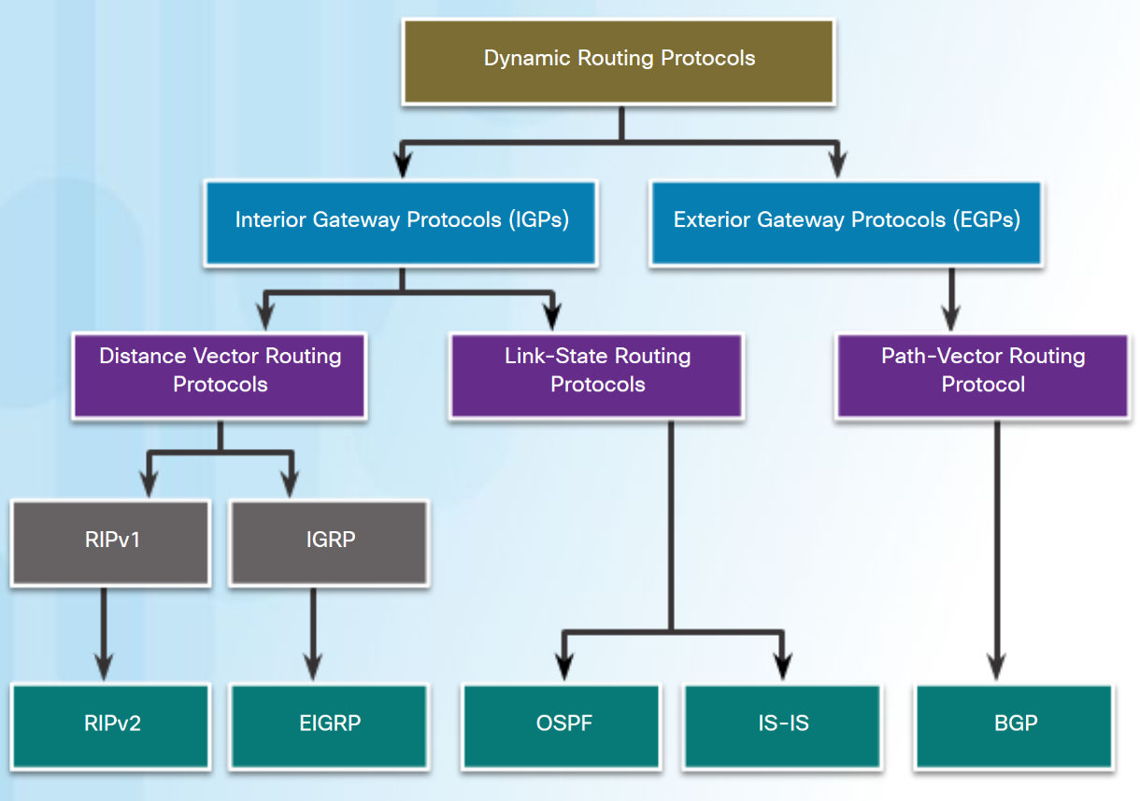
Types of Routing Protocols Classifying Routing Protocols
The purpose of dynamic routing protocols includes:
Discovery of remote networks.
Maintaining up-to-date routing information.
Choosing the best path to destination networks.
Ability to find a new best path if current path is no longer available.
Notes:
5.1 – Dynamic Routing Protocols
5.1.1 – Types of Routing Protocols
5.1.1.1 – Classifying Routing Protocols

Slide 15
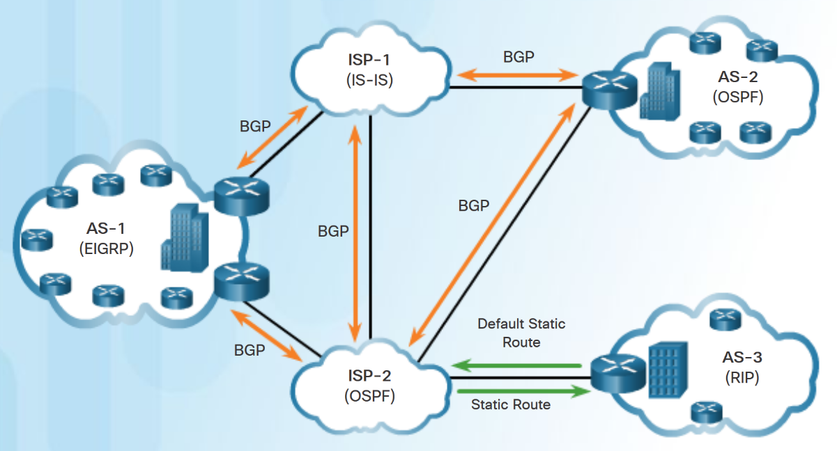
Types of Routing Protocols IGP and EGP Routing Protocols
Interior Gateway Protocols (IGP) - Used for routing within an Autonomous System (AS).
RIP, EIGRP, OSPF, and IS-IS.
Exterior Gateway Protocols (EGP) - Used for routing between Autonomous Systems.
BGP
Notes:
5.1 – Dynamic Routing Protocols
5.1.1 – Types of Routing Protocols
5.1.1.2 – IGP and EGP Routing Protocols

Slide 16
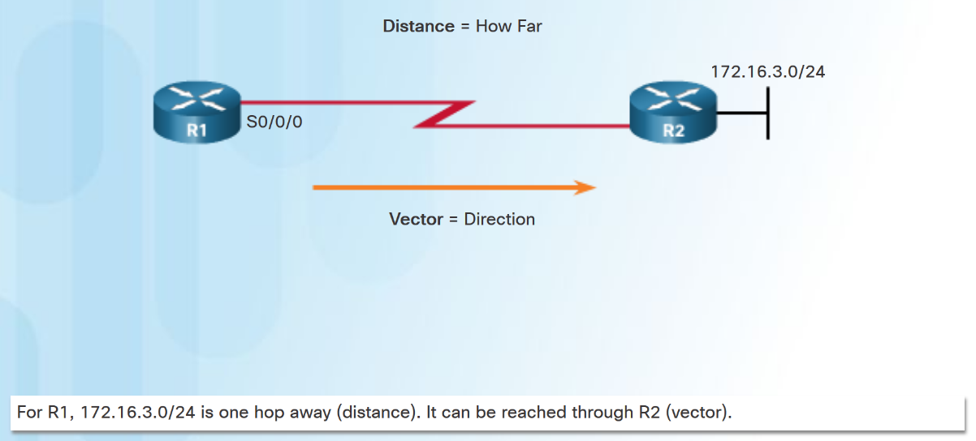
Types of Routing Protocols Distance Vector Routing Protocols
Distance vector means that routes are advertised by providing two characteristics:
Distance - Identifies how far it is to the destination network based on a metric such as hop count, cost, bandwidth, delay.
Vector - Specifies the direction of the next-hop router or exit interface to reach the destination.
RIPv1 (legacy), RIPv2, IGRP Cisco proprietary (obsolete), EIGRP.
Notes:
5.1 – Dynamic Routing Protocols
5.1.1 – Types of Routing Protocols
5.1.1.3 – Distance Vector Routing Protocols

Slide 17
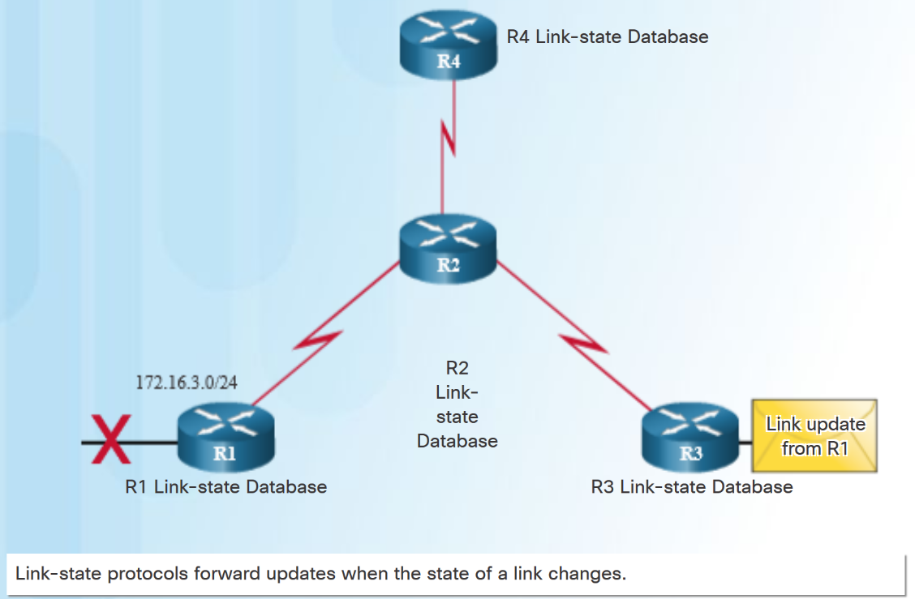
Types of Routing Protocols Link-State Routing Protocols
A link-State router uses the link-state information received from other routers:
to create a topology map.
to select the best path to all destination networks in the topology.
Link-state routing protocols do not use periodic updates.
updates are only sent when there is a change in the topology
OSPF and IS-IS
Notes:
5.1 – Dynamic Routing Protocols
5.1.1 – Types of Routing Protocols
5.1.1.4 – Link-State Routing Protocols

Slide 18
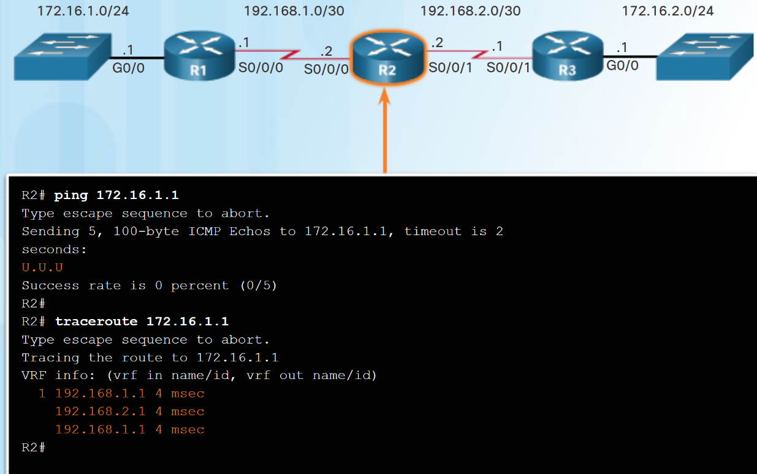
Types of Routing Protocols Classful Routing Protocols
Classless routing protocols include subnet mask information in the routing updates.
Classful routing protocols do not send subnet mask information in routing updates.
Classful routing protocols cannot support variable-length subnet masks (VLSMs) and classless interdomain routing (CIDR).
Classful routing protocols also create problems in discontiguous networks.
Notes:
5.1 – Dynamic Routing Protocols
5.1.1 – Types of Routing Protocols
5.1.1.5 – Classful Routing Protocols

Slide 19
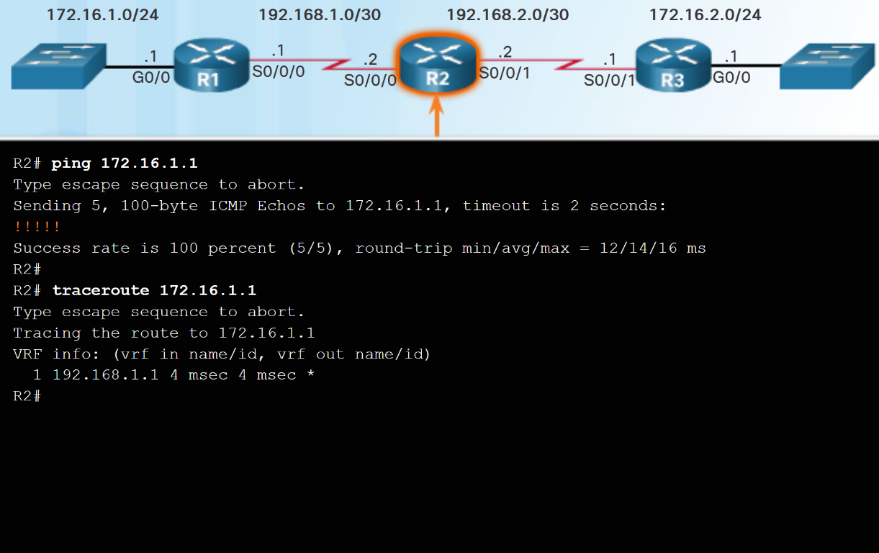
Types of Routing Protocols Classless Routing Protocols
Classless IPv4 routing protocols (RIPv2, EIGRP, OSPF, and IS-IS) all include the subnet mask information in routing updates.
Classless routing protocols support VLSM and CIDR.
IPv6 routing protocols are classless.
Notes:
5.1 – Dynamic Routing Protocols
5.1.1 – Types of Routing Protocols
5.1.1.6 – Classless Routing Protocols

Slide 20
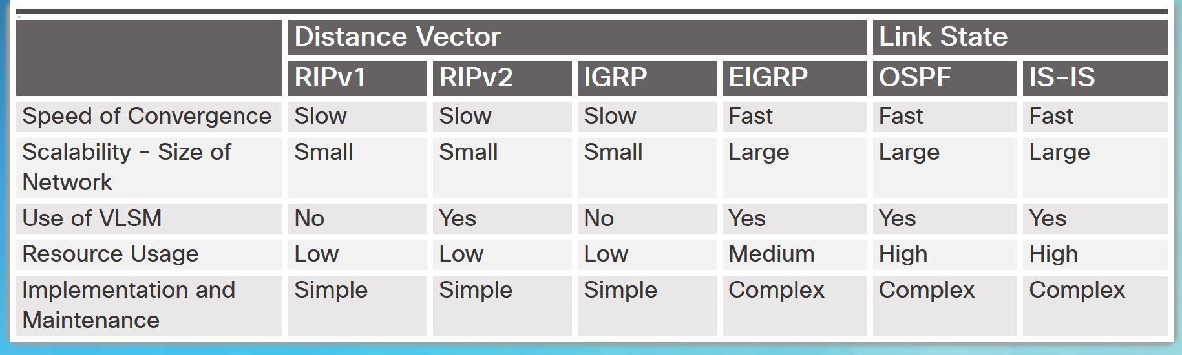
Types of Routing Protocols Routing Protocol Characteristics
Routing protocols can be compared based on the characteristics in the chart.
Notes:
5.1 – Dynamic Routing Protocols
5.1.1 – Types of Routing Protocols
5.1.1.7 – Routing Protocol Characteristics

Slide 21
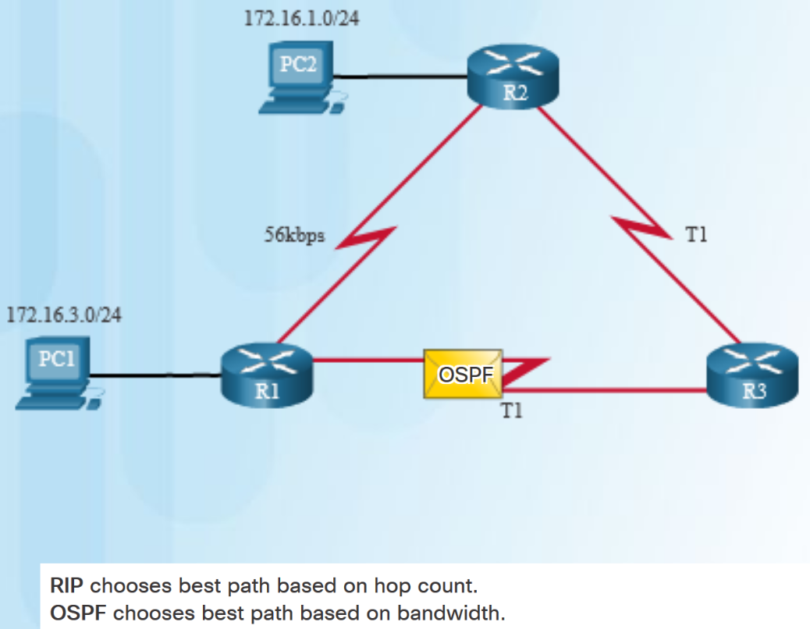
Types of Routing Protocols Routing Protocol Metrics
A metric is a measurable value that is assigned by the routing protocol to different routes based on the usefulness of that route.
Routing metrics are used to determine the overall “cost” of a path from source to destination.
Best path is route with the lowest cost.
Metrics used by various dynamic protocols:
RIP – Hop count
OSPF – Cost based on cumulative bandwidth
EIGRP - Bandwidth, delay, load, and reliability.
Notes:
5.1 – Dynamic Routing Protocols
5.1.1 – Types of Routing Protocols
5.1.1.8 – Routing Protocol Metrics

Slide 22
5.2 Distance Vector Dynamic Routing
Notes:
5 – Dynamic Routing
5.2 – Distance Vector Dynamic Routing

Slide 23
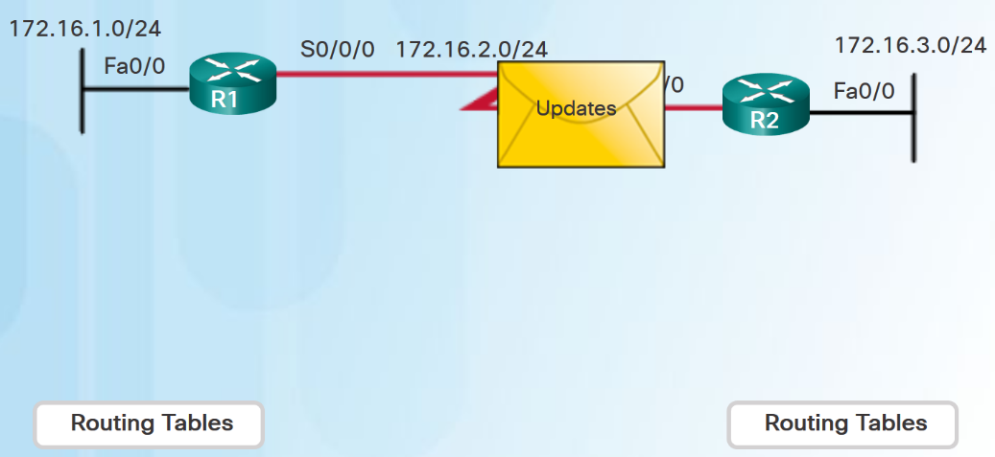
Distance Vector Fundamentals Dynamic Routing Protocol Operation
Operation of a dynamic routing protocol can be described as follows:
The router sends and receives routing messages on its interfaces.
The router shares routing messages and routing information with other routers using the same routing protocol.
Routers exchange routing information to learn about remote networks.
When a router detects a topology change, the routing protocol can advertise this change to other routers.
Notes:
5.2 – Distance Vector Dynamic Routing
5.2.1 – Distance Vector Fundamentals
5.2.1.1 – Dynamic Routing Protocol Operation

Slide 24
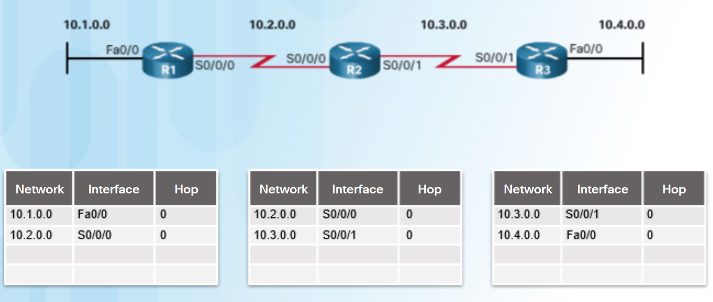
Distance Vector Fundamentals Cold Start
After a router boots successfully it applies the saved configuration, then the router initially discovers its own directly connected networks.
It adds those directly connected interface IP addresses to its routing table
Notes:
5.2 – Distance Vector Dynamic Routing
5.2.1 – Distance Vector Fundamentals
5.2.1.2 – Cold Start

Slide 25
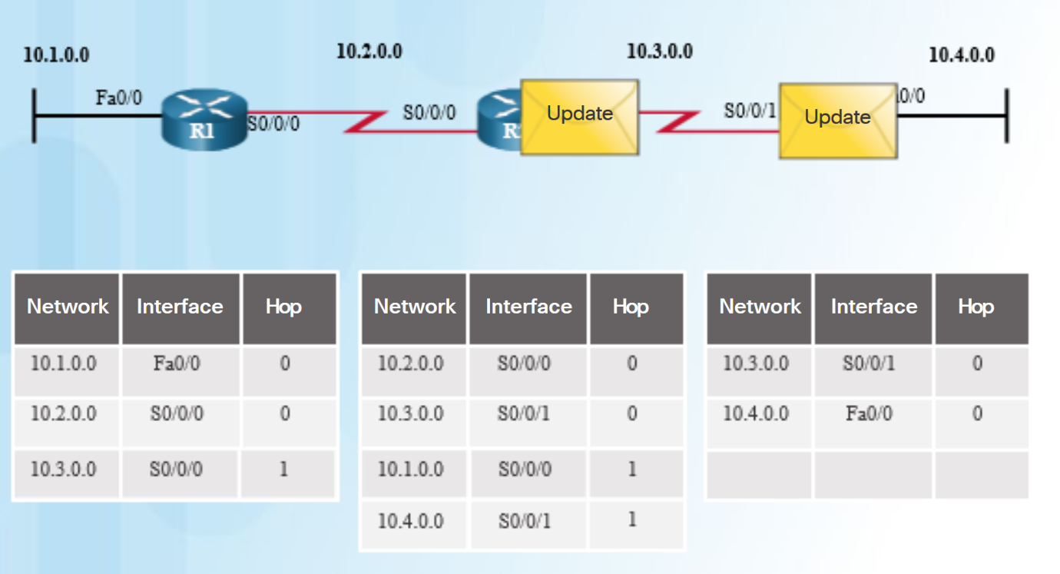
Distance Vector Fundamentals Network Discovery
If a routing protocol is configured, the router exchanges routing updates to learn about any remote routes.
The router sends an update packet with its routing table information out all interfaces.
The router also receives updates from directly connected routers and adds new information to its routing table.
Notes:
5.2 – Distance Vector Dynamic Routing
5.2.1 – Distance Vector Fundamentals
5.2.1.3 – Network Discovery

Slide 26
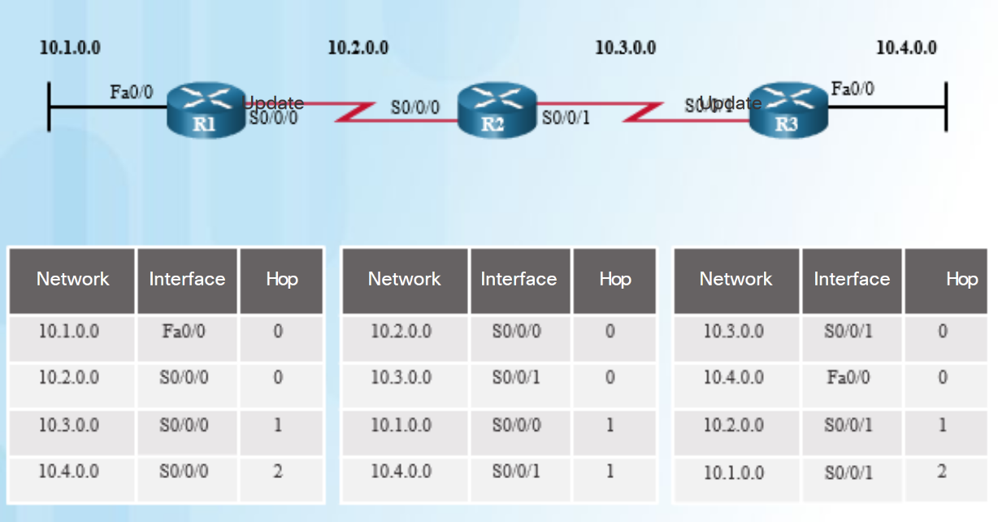
Distance Vector Fundamentals Exchanging the Routing Information
Working toward convergence, the routers exchange the next round of periodic updates.
Distance vector routing protocols use split horizon to avoid loops.
Split horizon prevents information from being sent out the same interface from which it was received.
Notes:
5.2 – Distance Vector Dynamic Routing
5.2.1 – Distance Vector Fundamentals
5.2.1.4 – Exchanging the Routing Information

Slide 27
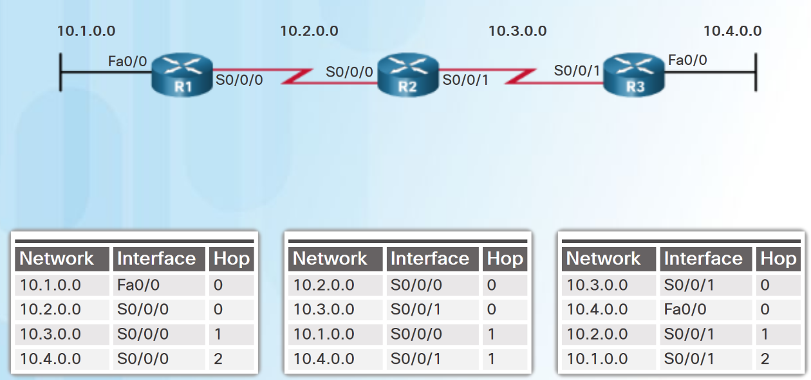
Distance Vector Fundamentals Achieving Convergence
The network has converged when all routers have complete and accurate information about the entire network
Convergence time is the time it takes routers to share information, calculate best paths, and update routing tables.
Routing protocols can be rated based on the speed to convergence; the faster the convergence, the better the routing protocol.
Notes:
5.2 – Distance Vector Dynamic Routing
5.2.1 – Distance Vector Fundamentals
5.2.1.5 – Achieving Convergence

Slide 28
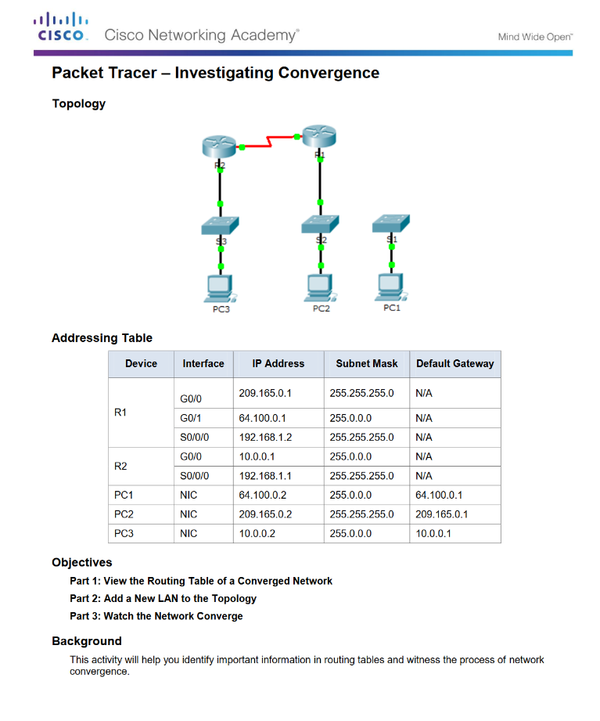
Distance Vector Fundamentals Packet Tracer - Investigating Convergence
Notes:
5.2 – Distance Vector Dynamic Routing
5.2.1 – Distance Vector Fundamentals
5.2.1.6 – Packet Tracer - Investigating Convergence

Slide 29
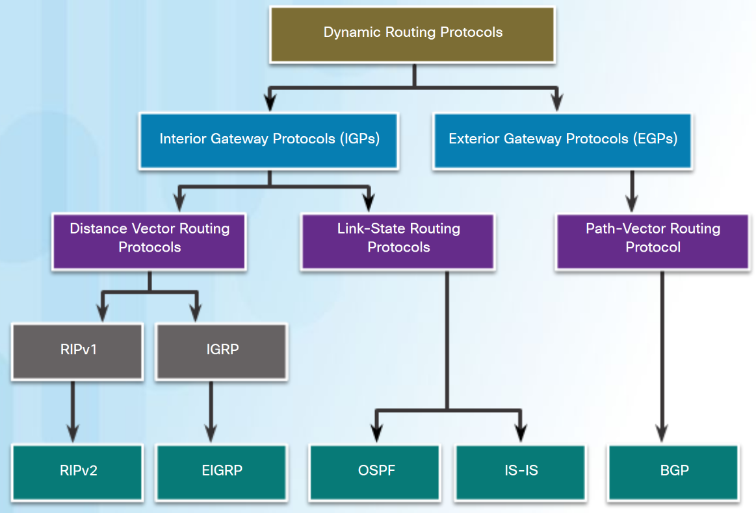
Distance Vector Routing Protocol Operation Distance Vector Technologies
Distance vector routing protocols share updates between neighbors.
Routers using distance vector routing are not aware of the network topology.
Some distance vector routing protocols send periodic updates.
RIPv1 sends updates as broadcasts 255.255.255.255.
RIPv2 and EIGRP can use multicast addresses to reach only specific neighbor routers.
EIGRP can use a unicast message to reach a specific neighbor router.
EIGRP only sends updates when needed, not periodically.
Notes:
5.2 – Distance Vector Dynamic Routing
5.2.2 – Distance Vector Routing Protocol Operation
5.2.2.1 – Distance Vector Technologies

Slide 30
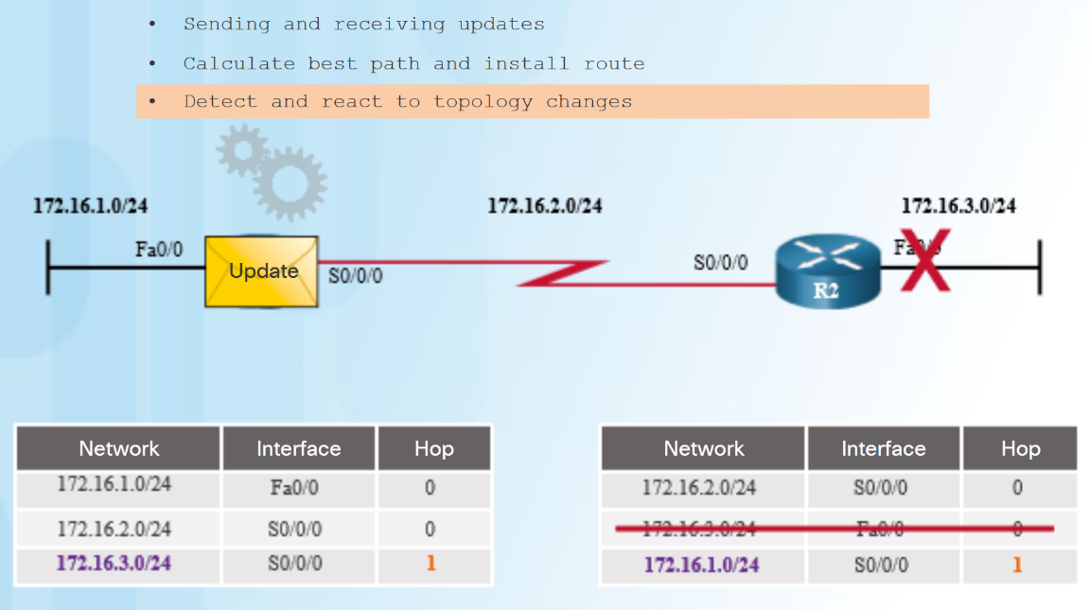
Distance Vector Routing Protocol Operation Distance Vector Algorithm
The distance vector algorithm defines the following processes:
Mechanism for sending and receiving routing information
Mechanism for calculating the best paths and installing routes in the routing table
Mechanism for detecting and reacting to topology changes
RIP uses the Bellman-Ford algorithm as its routing algorithm.
IGRP and EIGRP use the Diffusing Update Algorithm (DUAL) routing algorithm.
Notes:
5.2 – Distance Vector Dynamic Routing
5.2.2 – Distance Vector Routing Protocol Operation
5.2.2.2 – Distance Vector Algorithm

Slide 31
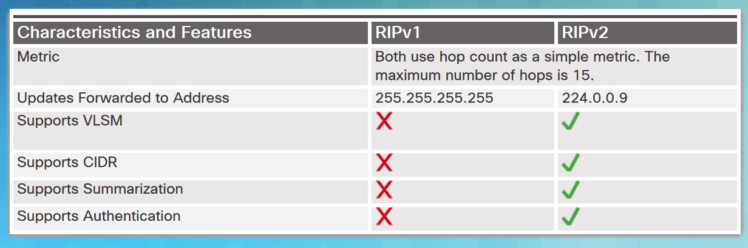
Types of Distance Vector Routing Protocols Routing Information Protocol
The Routing Information Protocol (RIP)
Easy to confgure
Routing updates broadcasted (255.255.255.255) every 30 seconds
Metric is hop count
15 hop limit
RIPv2
Classless routing protocol - supports VLSM and CIDR
Increased efficiency – sends updates to multicast address 224.0.0.9
Reduced routing entries - supports manual route summarization
Secure - supports authentication
RIPng
IPv6 enabled version of RIP
15 hop limit and administrative distance is 120
Notes:
5.2 – Distance Vector Dynamic Routing
5.2.3 – Types of Distance Vector Routing Protocols
5.2.3.1 – Routing Information Protocol

Slide 32
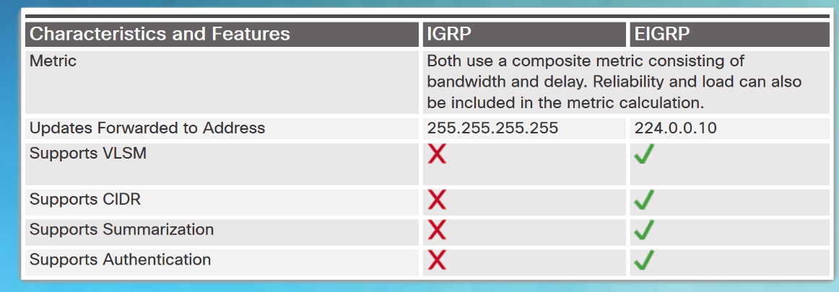
Types of Distance Vector Routing Protocols Enhanced Interior-Gateway Routing Protocol
EIGRP replaced IGRP in 1992. It includes the following features:
Bounded triggered updates – sends updates only to routers that need it.
Hello keepalive mechanism - Hello messages are periodically exchanged to maintain adjacencies.
Maintains a topology table - maintains all the routes received from neighbors (not only the best paths) in a topology table.
Rapid convergence – because it maintains alternate routes.
Multiple network layer protocol support – uses Protocol Dependent Modules (PDM) to support layer 3 protocols.
Notes:
5.2 – Distance Vector Dynamic Routing
5.2.3 – Types of Distance Vector Routing Protocols
5.2.3.2 – Enhanced Interior-Gateway Routing Protocol

Slide 33
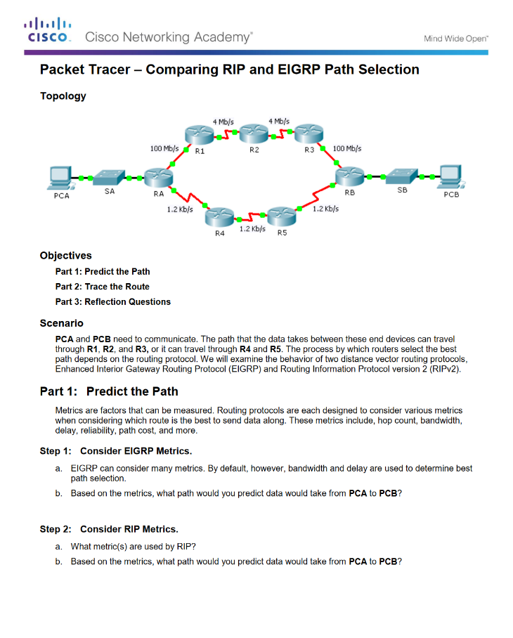
Types of Distance Vector Routing Protocols Packet Tracer - Comparing RIP and EIGRP Path Selection
Notes:
5.2 – Distance Vector Dynamic Routing
5.2.3 – Types of Distance Vector Routing Protocols
5.2.3.4 – Packet Tracer - Comparing RIP and EIGRP Path Selection

Slide 34
5.3 Link-State Dynamic Routing
Notes:
5 – Dynamic Routing
5.3 – Link-State Dynamic Routing

Slide 35
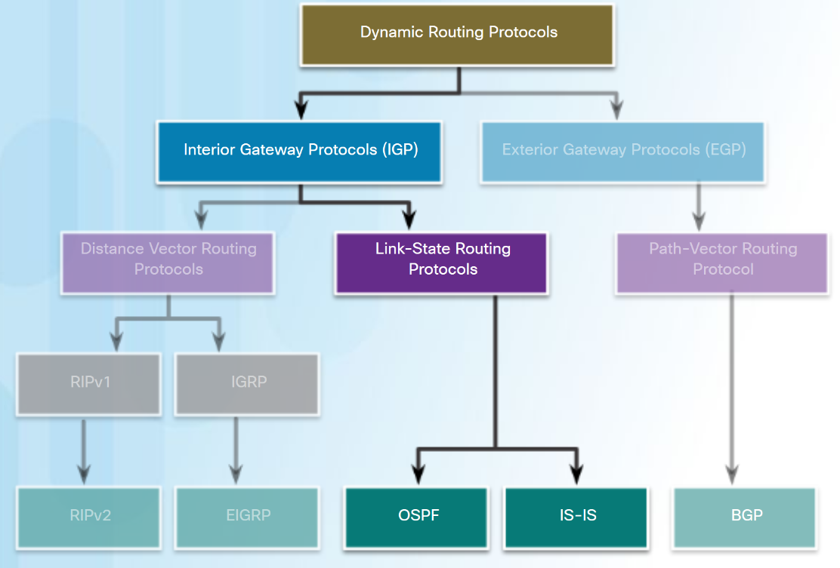
Link-State Routing Protocol Operation Shortest Path First Protocols
Link-state routing protocols, also known as shortest path first protocols, are built around Edsger Dijkstra's shortest path first (SPF) algorithm.
IPv4 Link-State routing protocols:
Open Shortest Path First (OSPF)
Intermediate System-to-Intermediate System (IS-IS)
Notes:
5.3 – Link-State Routing Protocols
5.3.1 – Link-State Routing Protocol Operation
5.3.1.1 – Shortest Path First Protocols

Slide 36
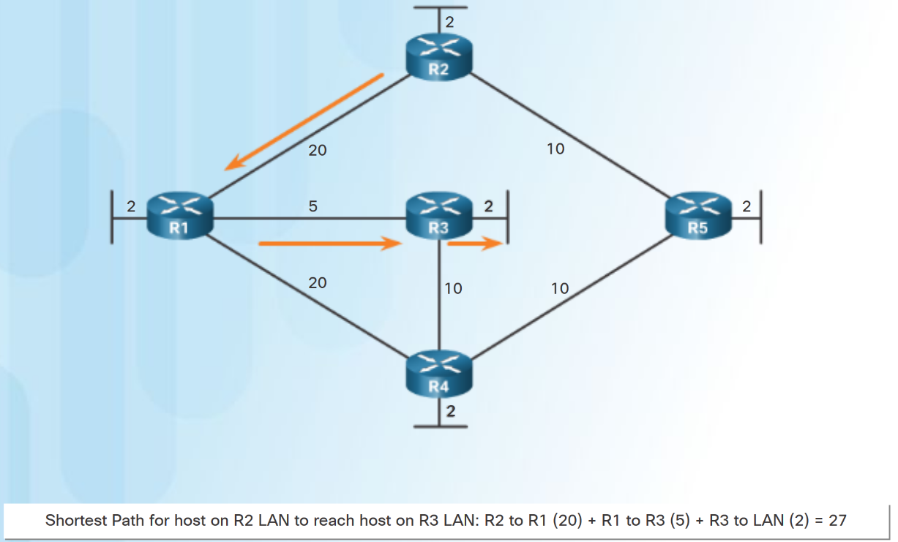
Link-State Routing Protocol Operation Dijkstra's Algorithm
All link-state routing protocols apply Dijkstra’s algorithm (also known as shortest path first (SPF)) to calculate the best path route:
Uses accumulated costs along each path, from source to destination.
Each router determines its own cost to each destination in the topology.
Notes:
5.3 – Link-State Routing Protocols
5.3.1 – Link-State Routing Protocol Operation
5.3.1.2 – Dijkstra's Algorithm

Slide 37
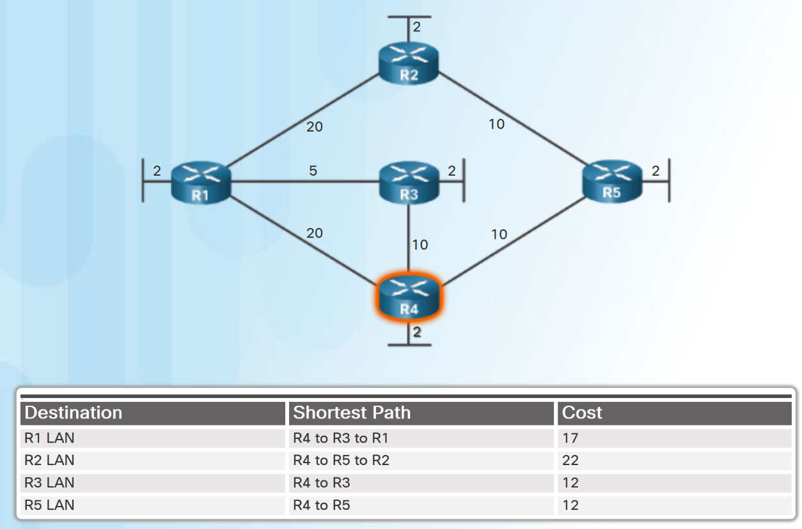
Link-State Routing Protocol Operation SPF Example
The table displays the shortest path and the accumulated cost to reach the identified destination networks from the perspective of R4.
Notes:
5.3 – Link-State Routing Protocols
5.3.1 – Link-State Routing Protocol Operation
5.3.1.3 – SPF Example

Slide 38
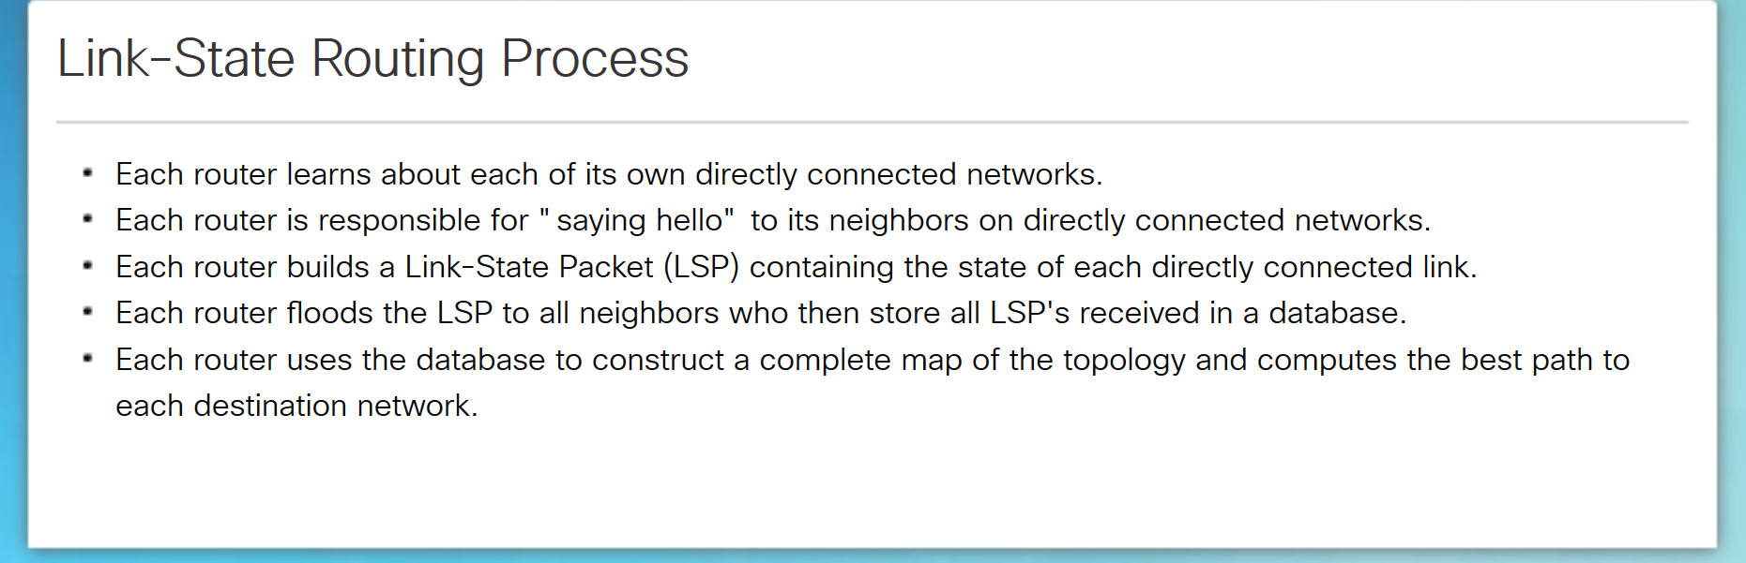
Link-State Updates Link-State Routing Process
Note: This process is the same for both OSPF for IPv4 and OSPF for IPv6.
Notes:
5.3 – Link-State Routing Protocols
5.3.2 – Link-State Updates
5.3.2.1 – Link-State Routing Process

Slide 39
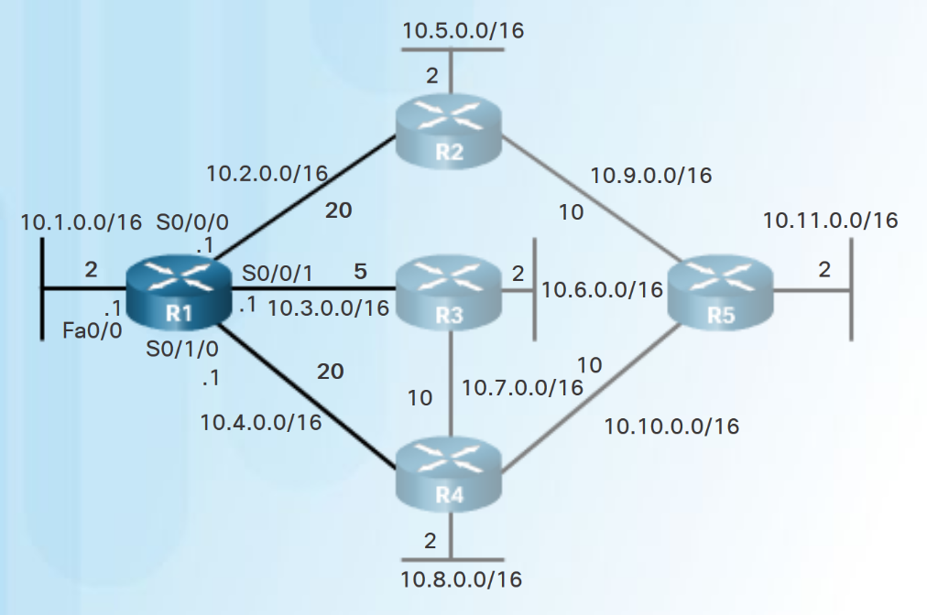
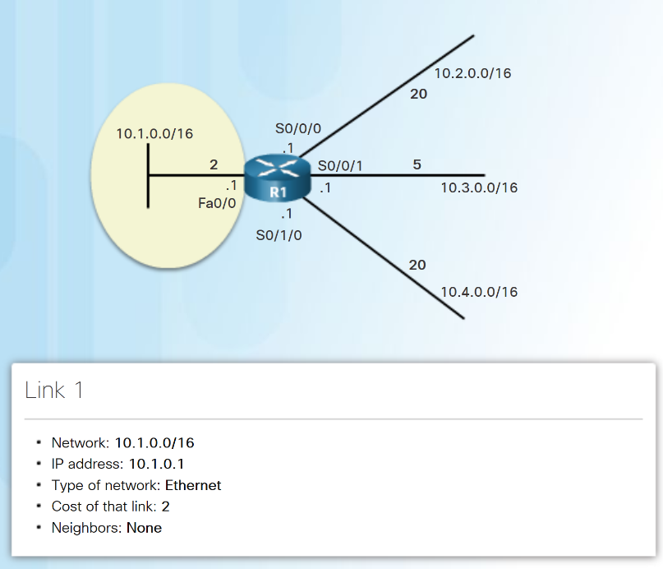
Link-State Updates Link and Link-State
The first step in the link-state routing process is that each router learns its own directly connected networks.
Notes:
5.3 – Link-State Routing Protocols
5.3.2 – Link-State Updates
5.3.2.2 – Link and Link-State

Slide 40
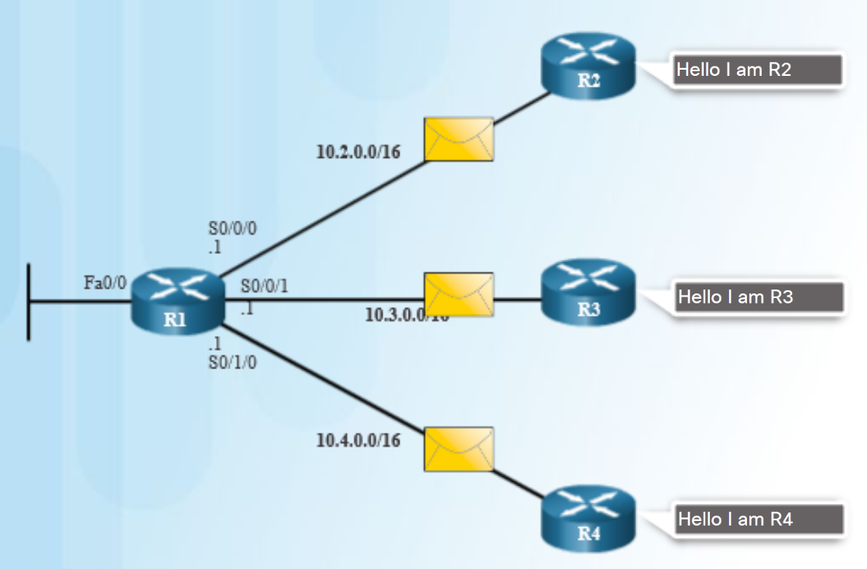
Link-State Updates Say Hello
The second step in the link-state routing process is that each router uses a Hello protocol to discover any neighbors on its links.
When two link-state routers learn that they are neighbors, they form an adjacency.
If a router stops receiving Hello packets from a neighbor, that neighbor is considered unreachable.
Notes:
5.3 – Link-State Routing Protocols
5.3.2 – Link-State Updates
5.3.2.3 – Say Hello

Slide 41
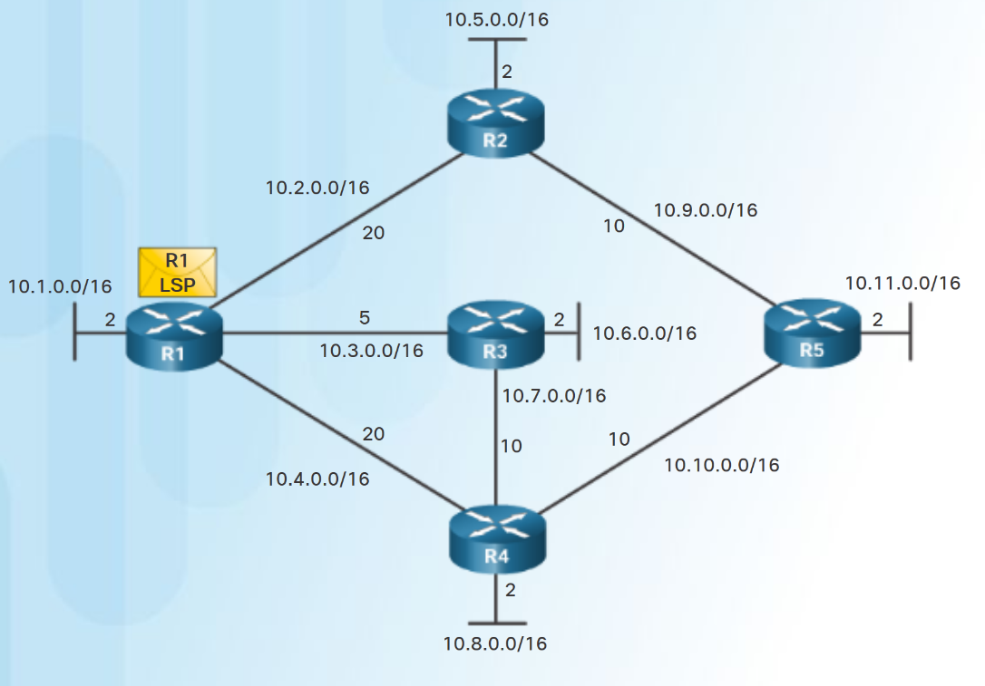
Link-State Updates Building the Link-State Packet
The third step in the link-state routing process is that each router builds a link-state packet (LSP) that contains the link-state information about its links.
R1 LSP (in diagram) would contain:
R1; Ethernet network 10.1.0.0/16; Cost 2
R1 -> R2; Serial point-to-point network; 10.2.0.0/16; Cost 20
R1 -> R3; Serial point-to-point network; 10.3.0.0/16; Cost 5
R1 -> R4; Serial point-to-point network; 10.4.0.0/16; Cost 20
Notes:
5.3 – Link-State Routing Protocols
5.3.2 – Link-State Updates
5.3.2.4 – Building the Link-State Packet

Slide 42
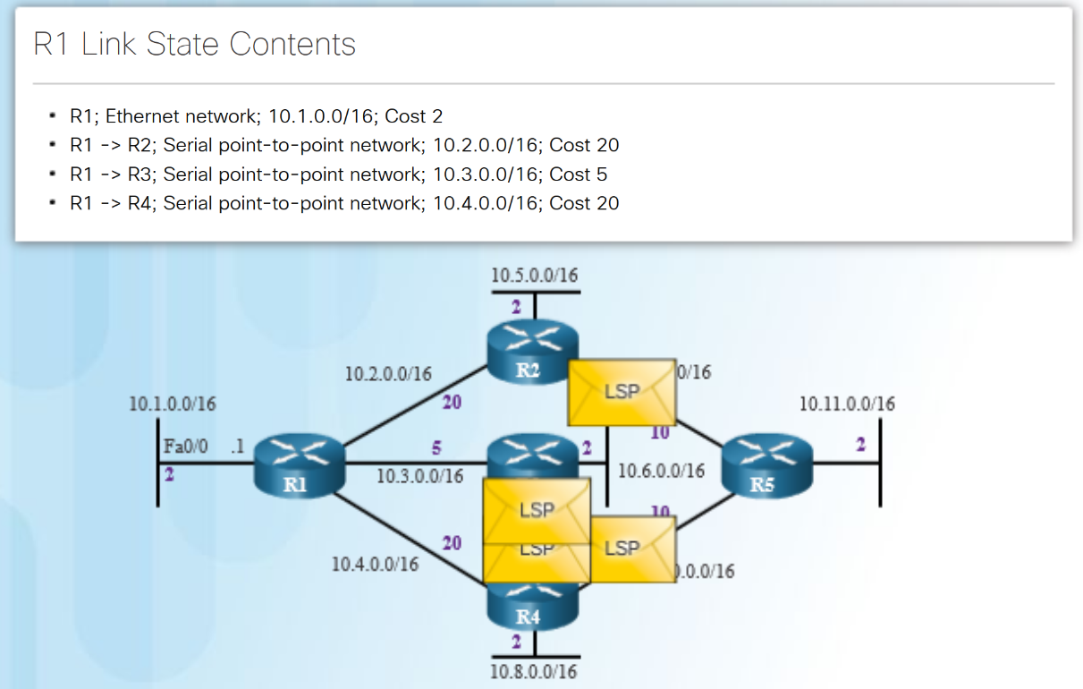
Link-State Updates Flooding the LSP
The fourth step in the link-state routing process is that each router floods the LSP to all neighbors.
An LSP only needs to be sent:
During initial startup of the routing protocol process on that router (e.g., router restart)
Whenever there is a change in the topology (e.g., a link going down)
An LSP also includes sequence numbers and aging information:
used by each router to determine if it has already received the LSP.
used to determine if the LSP has newer information.
Notes:
5.3 – Link-State Routing Protocols
5.3.2 – Link-State Updates
5.3.2.5 – Flooding the LSP

Slide 43
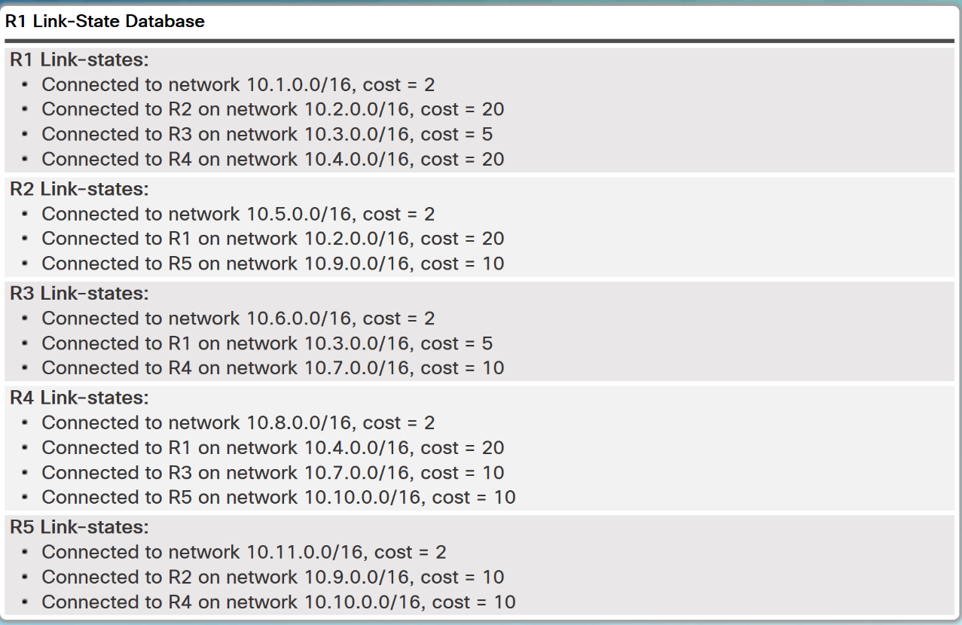
Link-State Updates Building the Link-State Database
The final step in the link-state routing process is that each router uses the database to construct a complete map of the topology and computes the best path to each destination network.
Notes:
5.3 – Link-State Routing Protocols
5.3.2 – Link-State Updates
5.3.2.6 – Building the Link-State Database

Slide 44
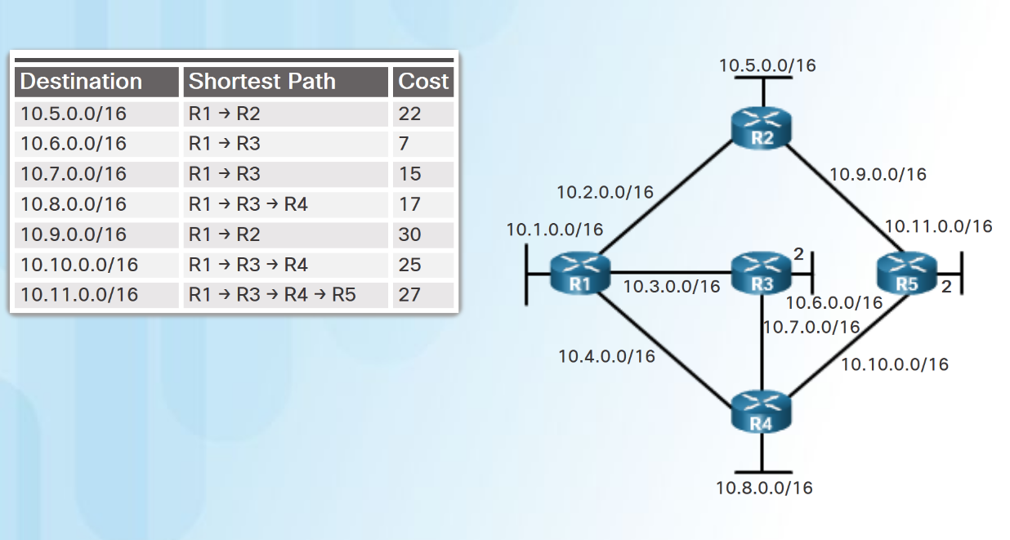
Link-State Updates Building the SPF Tree
Each router uses the link-state database and SPF algorithm to construct the SPF tree.
R1 identifies its directly connected networks and costs.
R1 adds any unknown networks and associated costs.
The SPF algorithm then calculates the shortest paths to reach each individual network resulting in the SPF tree shown in the diagram.
Each router constructs its own SPF tree independently from all other routers.
Notes:
5.3 – Link-State Routing Protocols
5.3.2 – Link-State Updates
5.3.2.7 – Building the SPF Tree

Slide 45
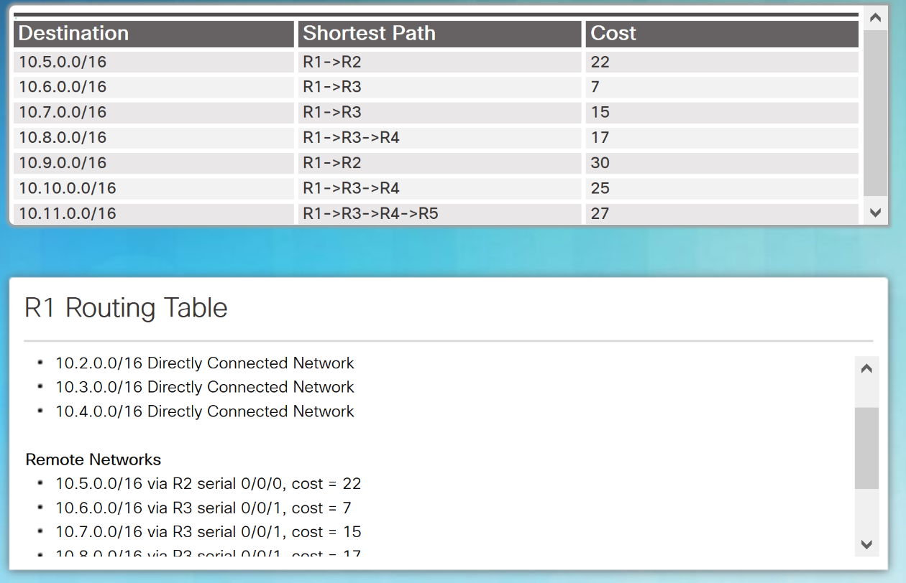
Link-State Updates Adding OSPF Routes to the Routing Table
Using the shortest path information determined by the SPF algorithm, these best paths are then added to the routing table.
Directly connected routes and static routes are also included in the routing table.
Notes:
5.3 – Link-State Routing Protocols
5.3.2 – Link-State Updates
5.3.2.8 – Adding OSPF Routes to the Routing Table

Slide 46
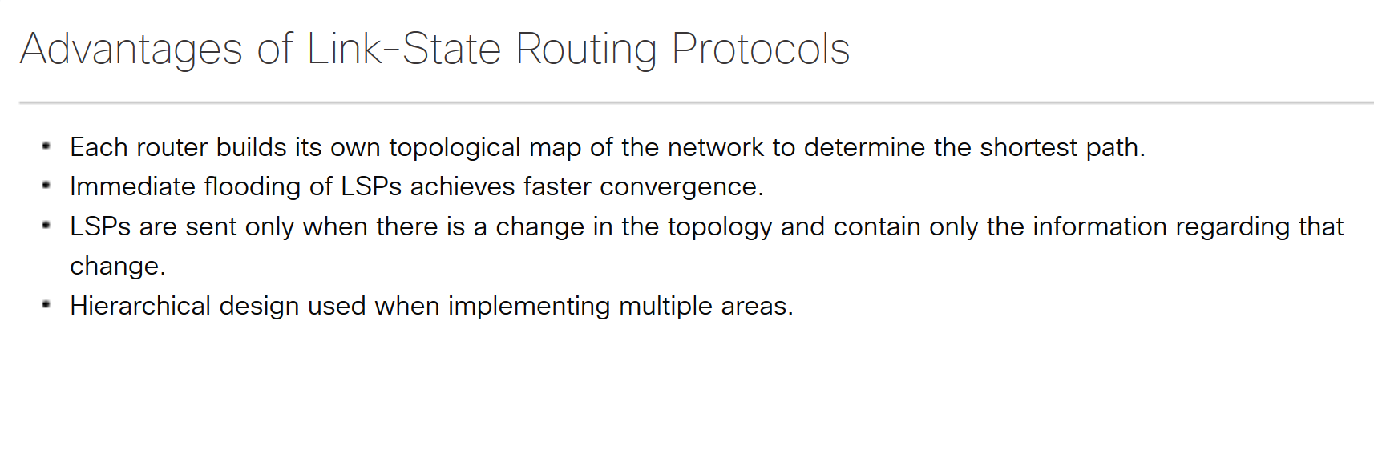
Link-State Routing Protocol Benefits Why Use Link-State Protocols?
Notes:
5.3 – Link-State Routing Protocols
5.3.3 – Link-State Routing Protocol Benefits
5.3.3.1 – Why Use Link-State Protocols?

Slide 47
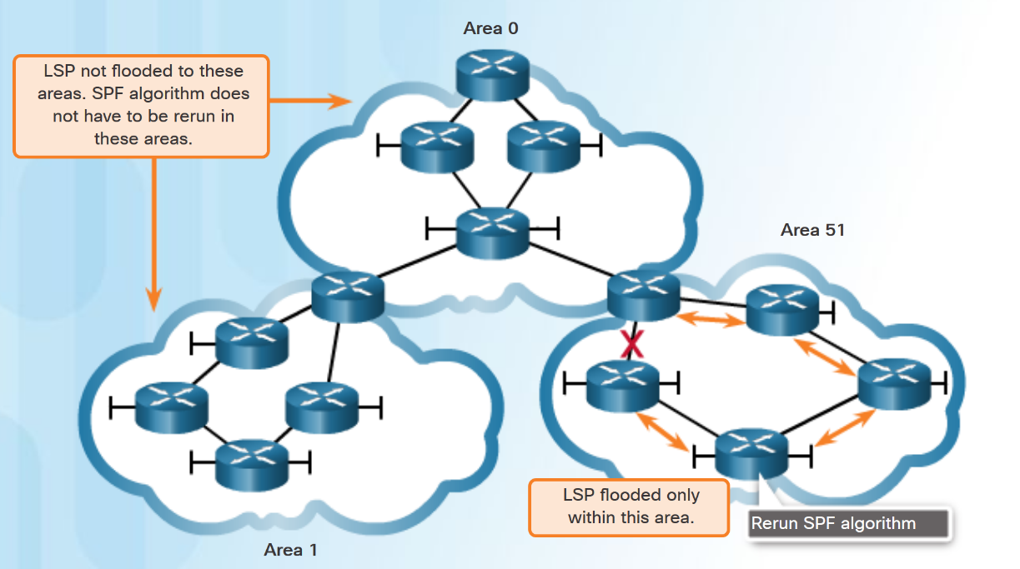
Link-State Routing Protocol Benefits Disadvantages of Link-State Protocols
Disadvantages of Link-State protocols:
Memory Requirements - Link-state protocols require additional memory.
Processing Requirements - Link-state protocols can require more CPU processing.
Bandwidth Requirements - The flooding of link-state packets can adversely affect bandwidth.
Using multiple areas can reduce the size of the link-state databases.
Multiple areas can limit the amount of link-state information flooding and send LSPs only to those routers that need them.
Notes:
5.3 – Link-State Routing Protocols
5.3.3 – Link-State Routing Protocol Benefits
5.3.3.2 – Disadvantages of Link-State Protocols

Slide 48
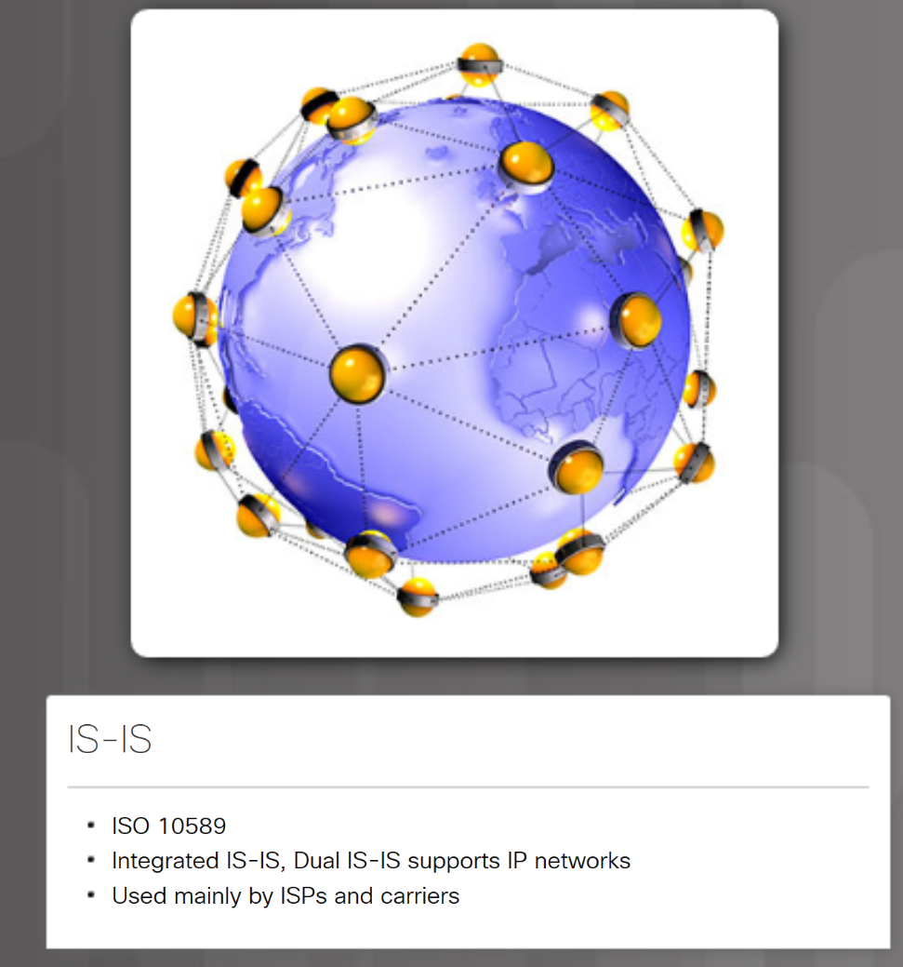
Link-State Routing Protocol Benefits Protocols that Use Link-State
Two link-state routing protocols, OSPF and IS-IS.Open Shortest Path First (OSPF) - most popular implementation with two versions in use:
OSPFv2- OSPF for IPv4 networks (RFC 1247 and RFC 2328)
OSPFv3- OSPF for IPv6 networks (RFC 2740)
Integrated IS-IS, or Dual IS-IS, includes support for IP networks.
used mainly by ISPs and carriers.
Notes:
5.3 – Link-State Routing Protocols
5.3.3 – Link-State Routing Protocol Benefits
5.3.3.3 – Protocols that Use Link-State

Slide 49
5.4 Chapter Summary
Notes:
5 – Dynamic Routing
5.4 – Summary

Slide 50
Conclusion Chapter 5: Dynamic Routing
Explain the features and characteristics of dynamic routing protocols.
Explain how distance vector routing protocols operate.
Explain how link-state protocols operate.
Notes:
5.4 – Summary
5.4.1 – Conclusion
5.4.1.1 – Chapter 5: Dynamic Routing

Slide 51
Chapter 5: Dynamic Routing New Terms and Commands
best path Interior Gateway Protocol (IGP) Exterior Gateway Protocol (EGP) path-vector classless Routing Information Protocol version 1 (RIPv1) Interior Gateway Routing Protocol (IGRP Routing Information Protocol version 2 (RIPv2 Enhanced Interior Gateway Routing Protocol (EIGRP) Open Shortest Path First (OSPF) Intermediate System to Intermediate System (IS-I Border Gateway Protocol (BGP) classless routing protocols autonomous system (AS) Distance | metric cost periodic updates neighbors Variable-Length Subnet Mask (VLSM) Classless Inter-Domain Routing (CIDR) convergence route summarization Bellman-Ford algorithm Dijkstra’s algorithm Shortest Path First (SPF) algorithm Diffusing Update Algorithm (DUAL) directly connected networks split horizon converge Convergence time
Notes:
New Terms and Commands

Slide 52
Chapter 5: Dynamic Routing New Terms and Commands (Cont.)
multicast addresses RIPng administrative distance SPF tree link state information OSPF area link-state routers Hello packets Link-State Packets (LSP) router ID All OSPF routers link-state database (LSDB) adjacency OSPFv2 OSPFv3
Notes:
New Terms and Commands

